Slide 1
Basics of Electrical Circuits
Özkan Karabacak
Oda No:2307
karabacak@itu.edu.tr

Slide 2
Grading
1 midterm exam | 5 November 2012 | %30
2 short exams | 15 October 2012 | %10
 | 26 November 2012 | %15
Final |  | %45

Slide 3
References:
L.O. Chua, C.A. Desoer, S.E. Kuh. “Linear and Nonlinear Circuits”
Mc.Graw Hill, 1987, New York ( Sections: 1-8, 12)
Yılmaz Tokad, “ Devre Analizi Dersleri” Kısım I, Çağlayan
Kitabevi, 1986.
Cevdet Acar, “Elektrik Devrelerinin Analizi” İ.T.Ü. Yayınları,
1995.

Slide 4
Circuit Theory
Goal: to predict the electrical behaviour of physical circuits
Physical circuit: interconnections of (physical) electric devices
Why(When) do we need to predict the electrical behaviour?
..........................................................................
..........................................................................
(Electrical) circuit: model of physical circuit
Domain of application: large-scale integrated circuits (fingernail size)
telecommunication and power circuits (continent size)
voltage μV MV
current pA MA
frequency 0 Hz 1GHz
power 10⁻¹⁴ W 10⁹ W

Slide 5
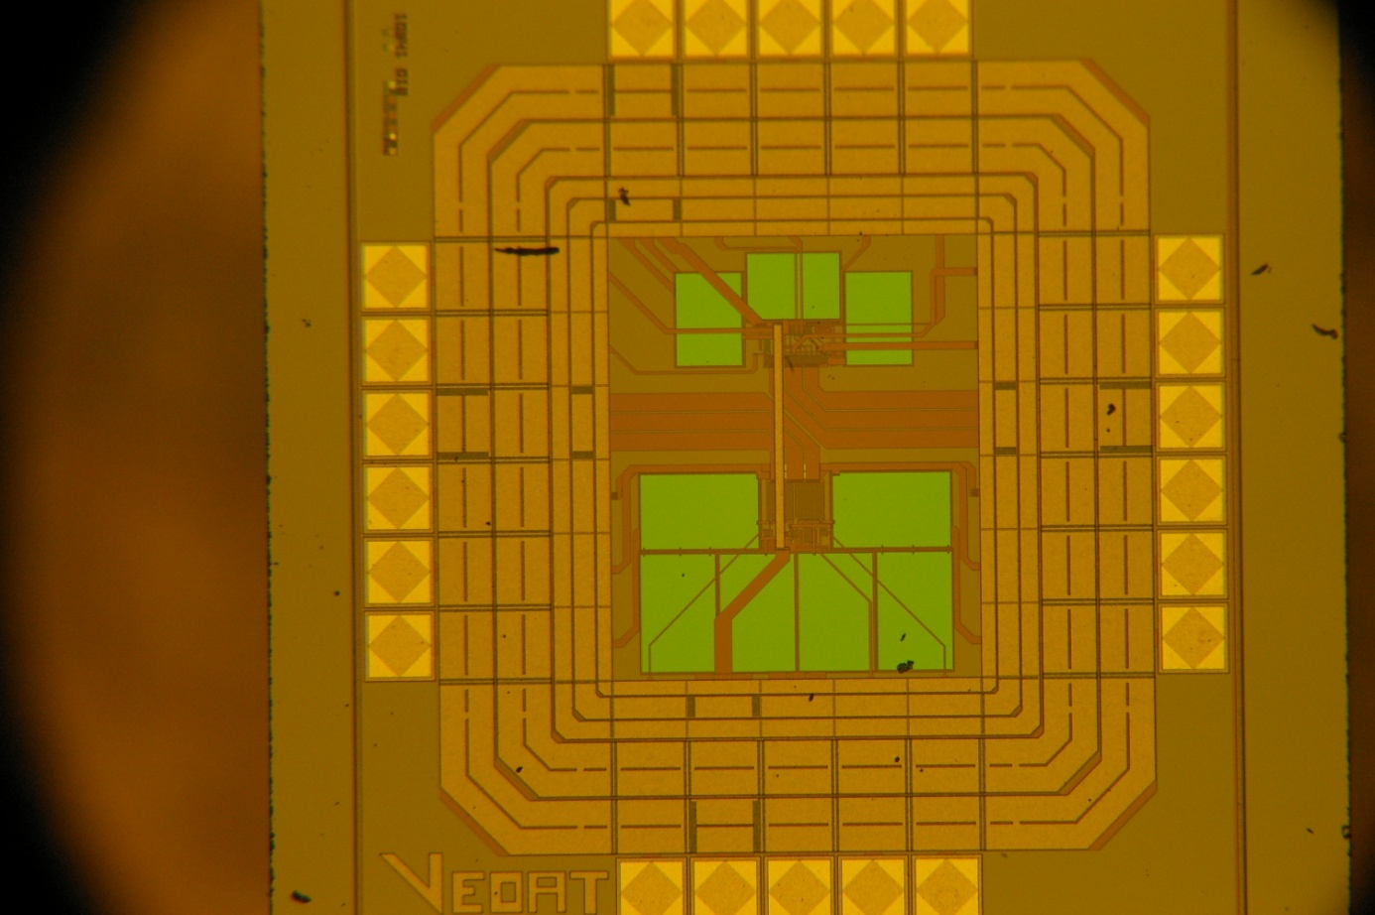
A physical circuit
Main unit of a random number generator: chaotic oscillators
Ahmet Şamil Demirkol, Serdar Özoğuz, Vedat Tavas

Slide 6
... and its model
comparator
MC1
kI₀
C₃
MC2
V_{DD}/2
I_{B}
I_{Cout}
I₀
I₀(1+ε)
2KI₀
MA
I₀+I_{Z}
I₀+I_{Y}
I₀+I_{X}
Me2
Me1
2(I₀+I_{X})
MB
I₀+I_{Y}
C₁
C₂

Slide 7
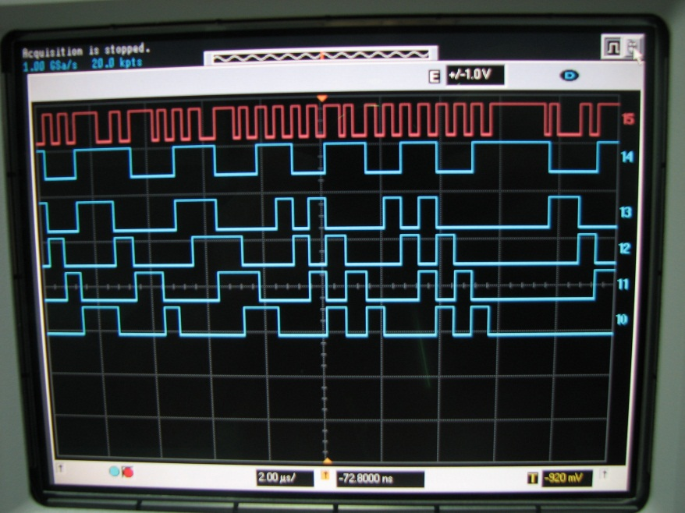
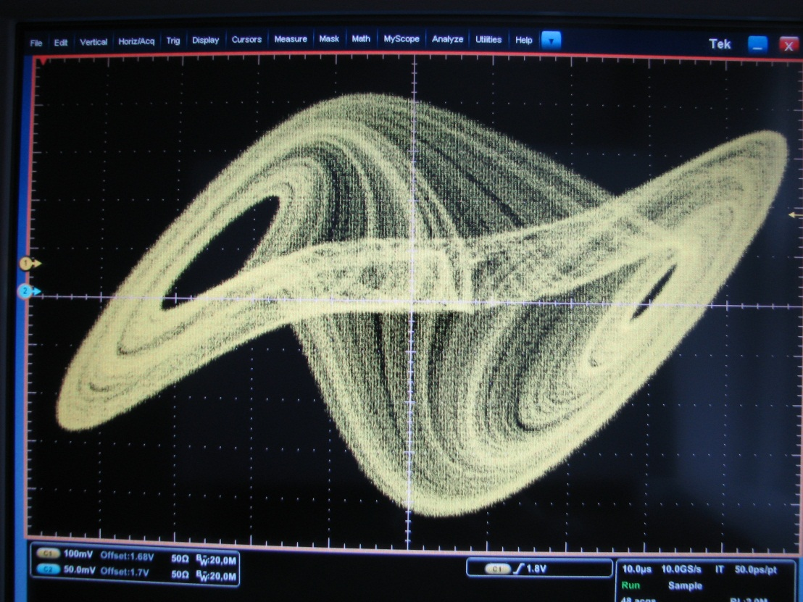
Oscilloscope images

Slide 8
How should we start building a theory?
undefined quantities
axioms
What else do we need?
for new quantities: definitions
for new results: theorems

Slide 9
Electrical Circuit Theory
undefined quantities
current voltage
i(t) [A] v(t) [V]
An electrical circuit
A
+
+
V
_
_

Slide 10
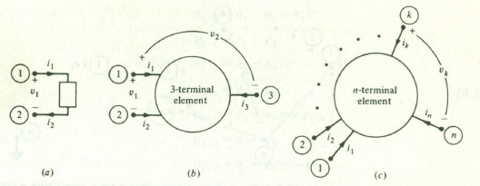
Be careful in directions!
The directions of currents and voltages in a circuit usually changes. Therefore, there is no (true) specific direction that can be assigned to these.
Nevertheless, we need directions before we start analysis. We proceed as follows: We choose directions arbitrarily. If after the analysis the value of a current is estimated as positive, then the actual direction of the current is the same as the (reference) direction you chose. If it is negative, then the actual direction is the opposite of the direction you chose.
reference direciton
+
sign
=
actual
direction
i₃(t₀)=(+/-)2A means current at time t₀ flows (into/out of) the device from terminal 3 in (b).
v_{k}(t₁)=(+/-)25V means that, at time t₁, the electric potential of the terminal k in (c) is 25V (larger/smaller) than the electric potential of terminal n.

Slide 11
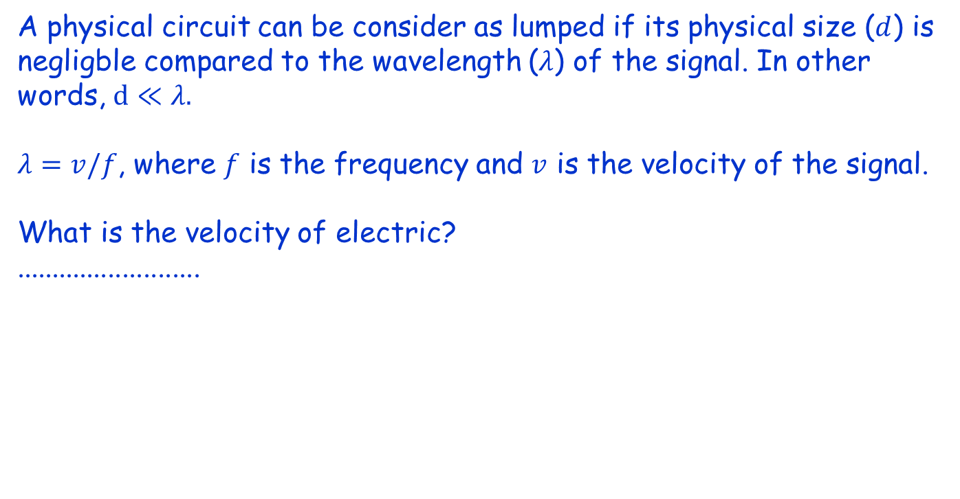
Axioms
1. Lumped circuit:
A physical circuit can be consider as lumped if its physical size ($d$) is negligble compared to the wavelength ($λ$) of the signal. In other words, $d≪λ.$
$λ=v/f$, where $f$ is the frequency and $v$ is the velocity of the signal.
What is the velocity of electric?
..........................

Slide 12
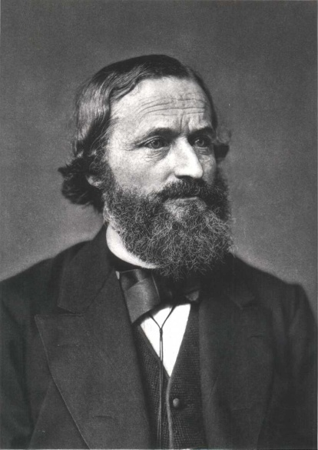
Axioms
2. Kirchhoff’s Voltage Law (KVL)
Given any connected, lumped circuit having n nodes, choose one of these nodes as a reference node.
Define n-1 node-to-reference voltages as shown in the figure below.
1
2
3
Denote the voltage difference between node k and node j by v_{kj} .
+
+
+
. . .
k
V_{kn-1}
+
. . .
1824-1887
e₁
e₂
n-1
e₃
+
_
e_{k}
_
_
e_{n-1}
_
e_{n}=0
_
n

Slide 13
Kirchhoff’s Voltage Law (KVL) in terms of node voltages
For all lumped connected circuits, for all choices of reference node, for all times t, for all pairs of nodes k and j,
Kirchhoff’s Voltage Law (KVL) for closed node sequences
For all lumped connected circuits, for all closed node sequences, for all times t, the algebraic sum of all node-to-node vol
Theorem:
KVL in terms of node voltages KVL for closed node sequences

Slide 14
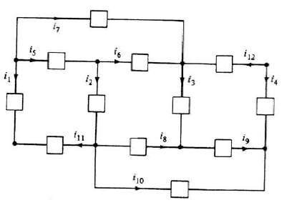
Example
Write the equations obtained from KVL in terms of node voltages.
Choose three closed node sequences and write three equations using KCL for closed node sequences.
1
2
3
4
5
6
7
8
L.O. Chua, C.A. Desoer, S.E. Kuh. “Linear and Nonlinear Circuits”, Mc.Graw Hill, 1987, New York

Slide 15
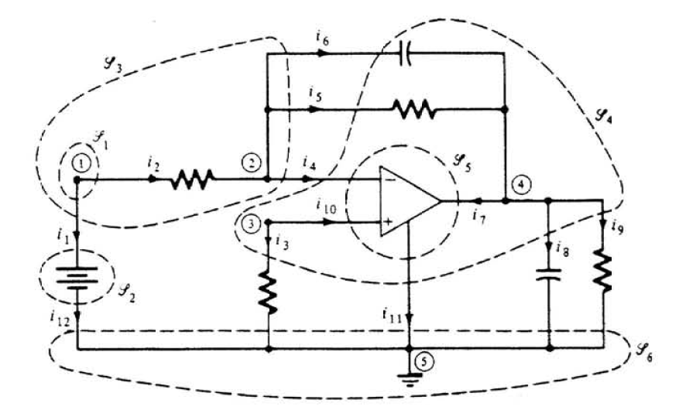
3. Kirchhoff’s Current Law (KCL)
Gaussian surface :
a closed surface. We choose such a surface such that it cuts only the connecting wires between the circuit elements but not the elements themselves or the nodes.
+
_

Slide 16
Kirchhoff’s Current Law (KCL) for Gaussian surfaces
For all lumped circuits, for all Gaussian surfaces, for all times t, the algebraic sum of all the currents leaving the Gaussian surface at time t is equal to zero.
Kirchhoff’s Current Law (KCL) for nodes
For all lumped circuits, for all times t, the algebraic sum of the currents leaving any node at time t is equal to zero.
Theorem:
KCL for Gaussian surfaces KCL for nodes

Slide 17
Example
Choose three Gaussian surfaces and write three equations using KCL for these Gaussian surfaces.
Write the equations obtained from KCL for nodes.
1
2
3
4
5
6
7
8
L.O. Chua, C.A. Desoer, S.E. Kuh. “Linear and Nonlinear Circuits”, Mc.Graw Hill, 1987, New York

Slide 18
Finally,
KVL and KCL equations can be obtained only for lumped circuits,
does not depend on the elements themselves,
does depend only on the connection structure
of the elements
are linear, algebraic, homogeneous equations
with coefficients 1,-1 or 0.

